Slide 1
Eulerian-on-Lagrangian Cloth Simulation
Team Member： 杜林峰 文嘉豪 程浩然

Slide 2
01
Introduction
Introduce the problem.
CONTENT
02
Physics simulation model
Bending, membrane force, external force.
03
Dynamic Remesh
Collision, preprocess, remesh
04
Result
demos

Slide 3
Introduction
Introduce the problem.

Slide 4
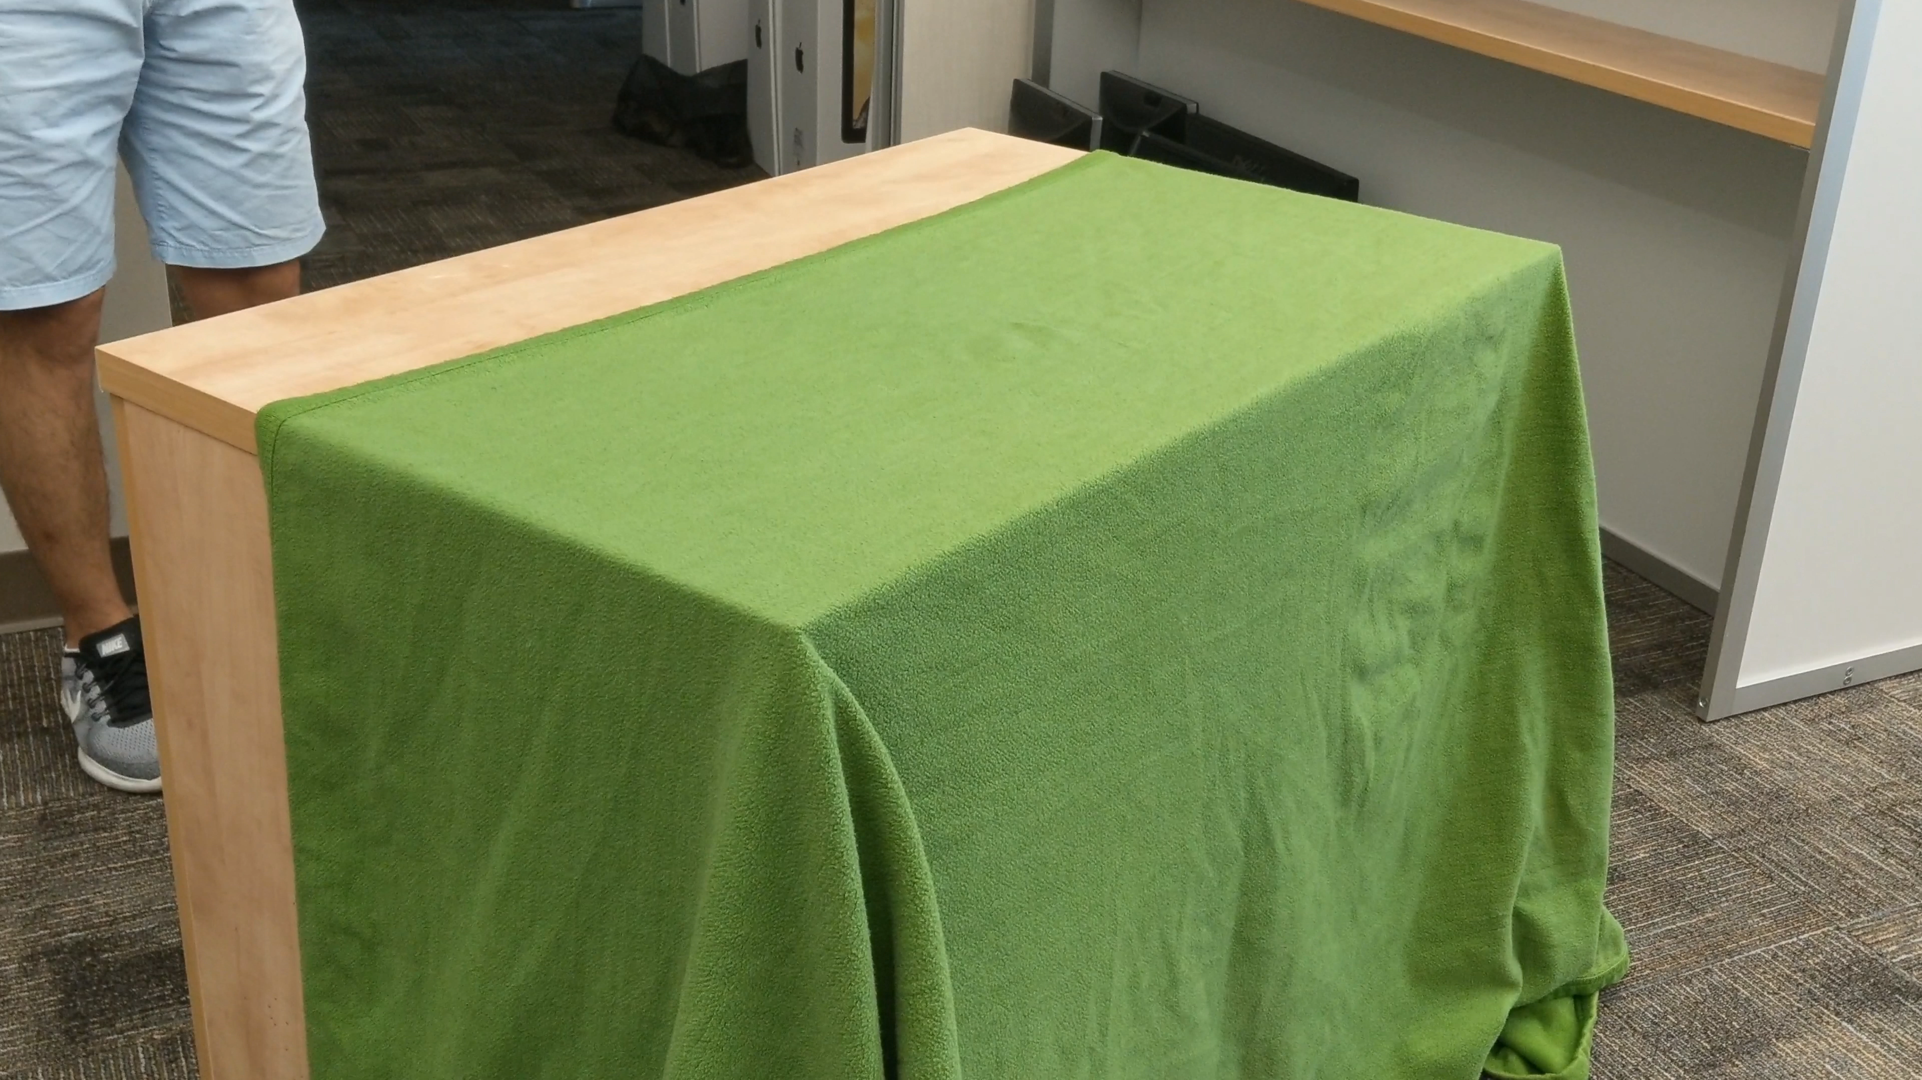
Introduction
Introduce the problem.

Slide 5
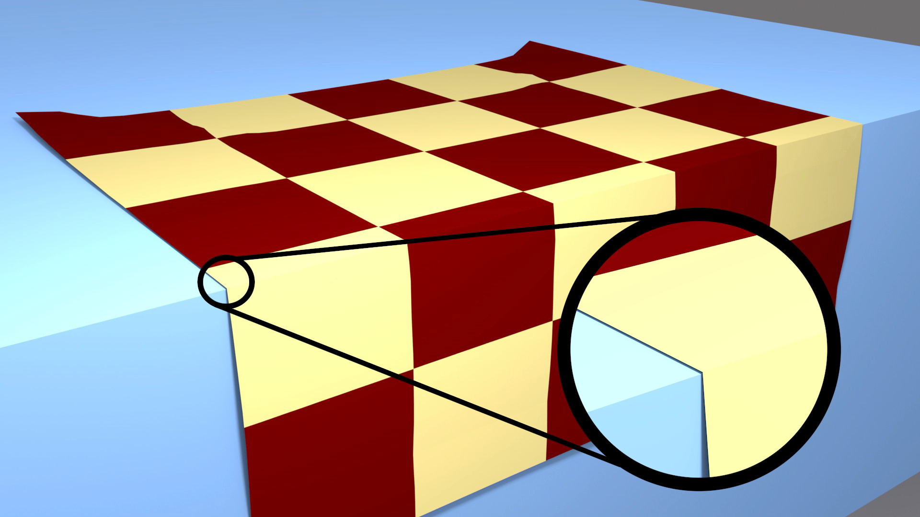
Introduction
Introduce the problem.

Slide 6
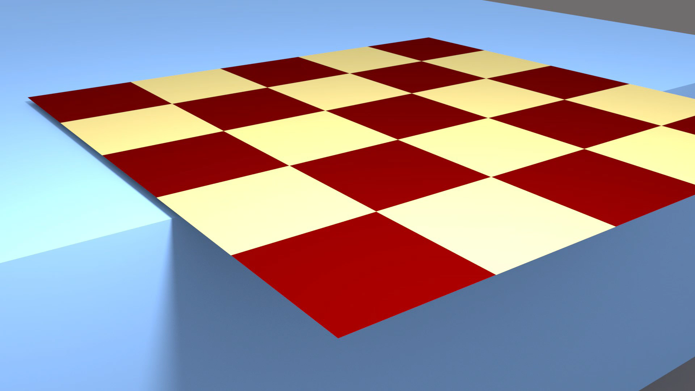
Introduction
Introduce the problem.

Slide 7
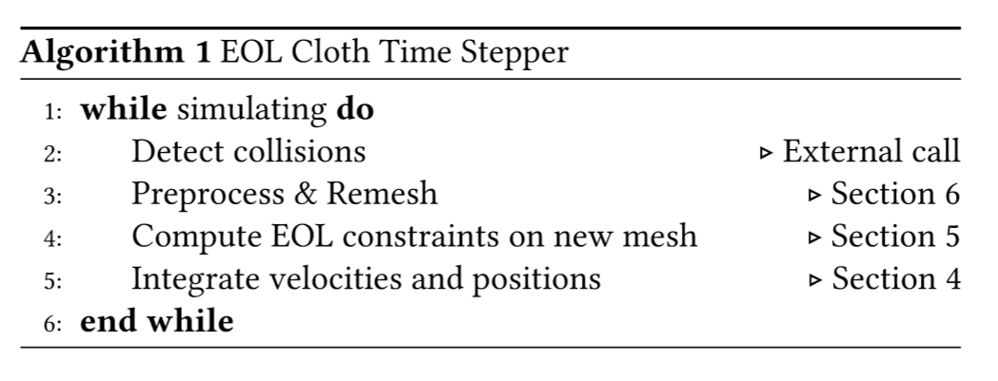
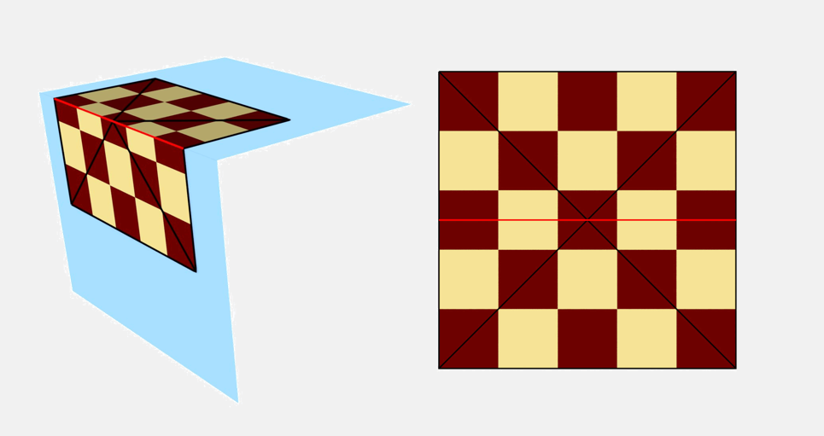
Introduction
Introduce the problem.

Slide 8
Physics simulation model
Bending, membrane, external.

Slide 9
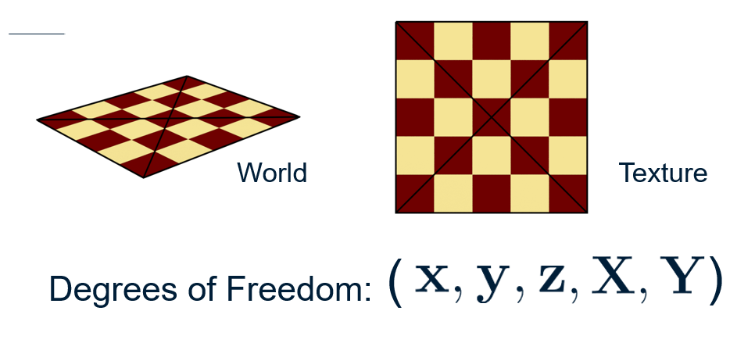
Physics simulation model
Bending, membrane, external.

Slide 10
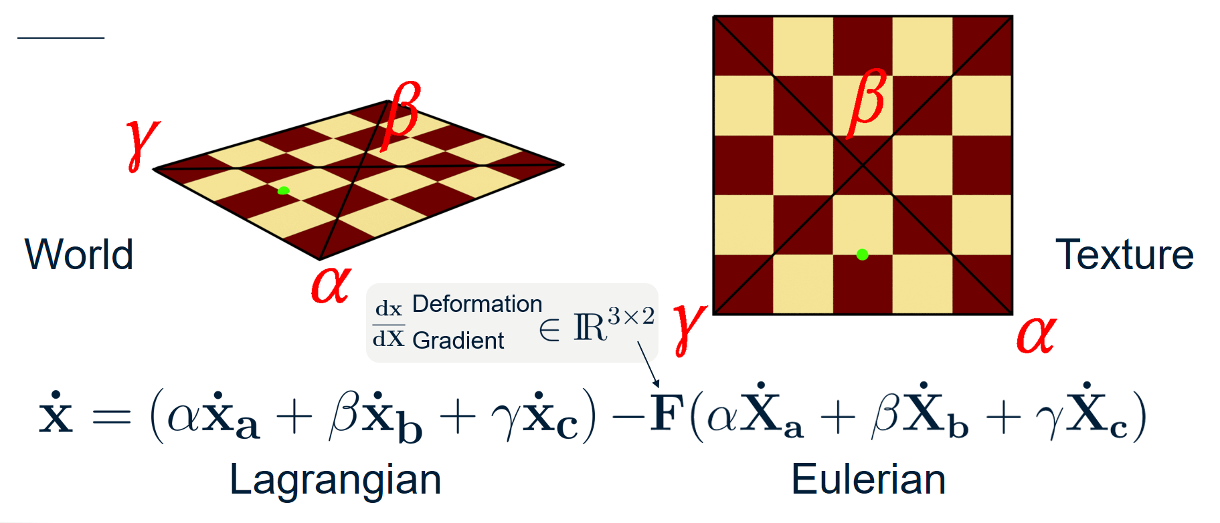
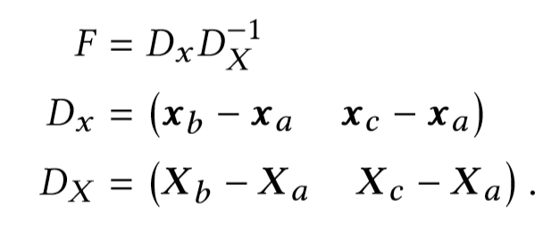
Physics simulation model
Bending, membrane, external.

Slide 11
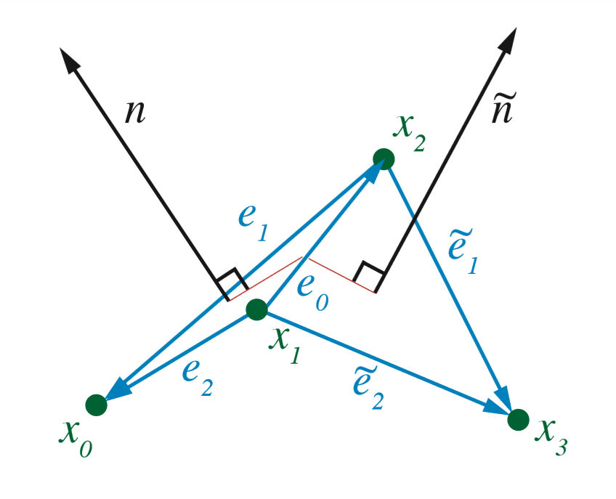
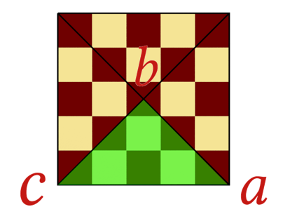
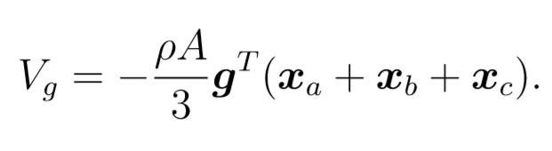
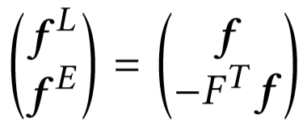
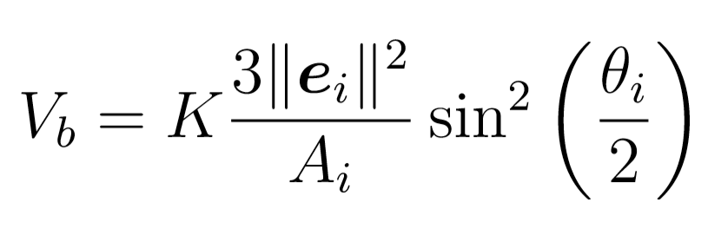
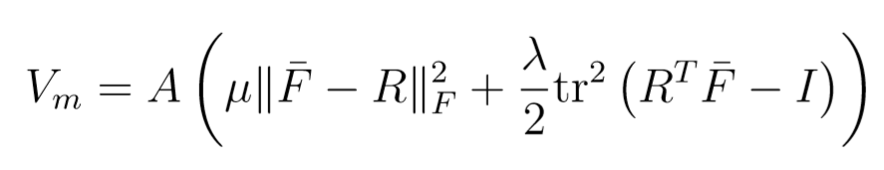
Physics simulation model
Bending, membrane, external.
Bending Force
Membrane Force
External Force
Discrete Willmore energy
Fem simulation of 3d deformable solids
Siggraph 2012
Translate

Slide 12
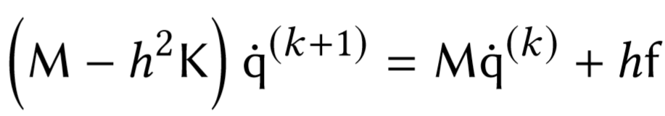
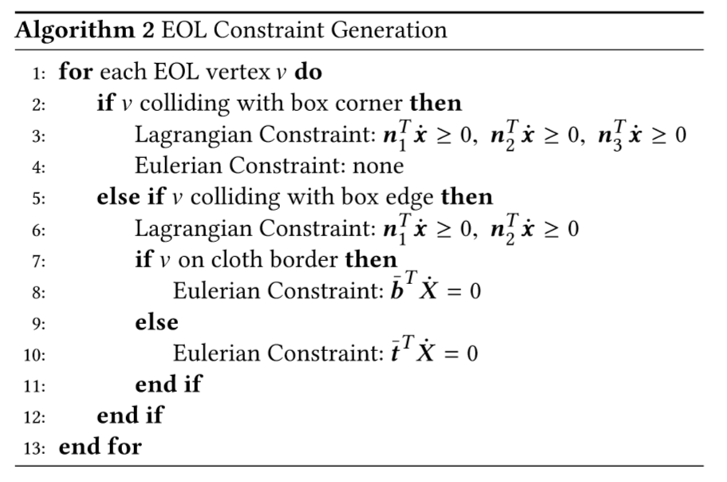
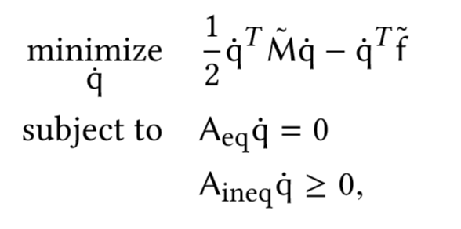

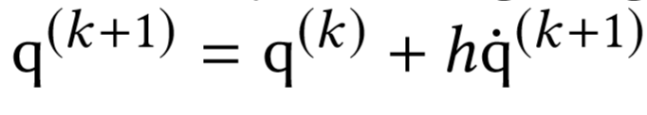
Physics simulation model
Bending, membrane, external.
Motion Function
Constraint

Slide 13
Dynamic Remesh
Collision, preprocess, remesh

Slide 14
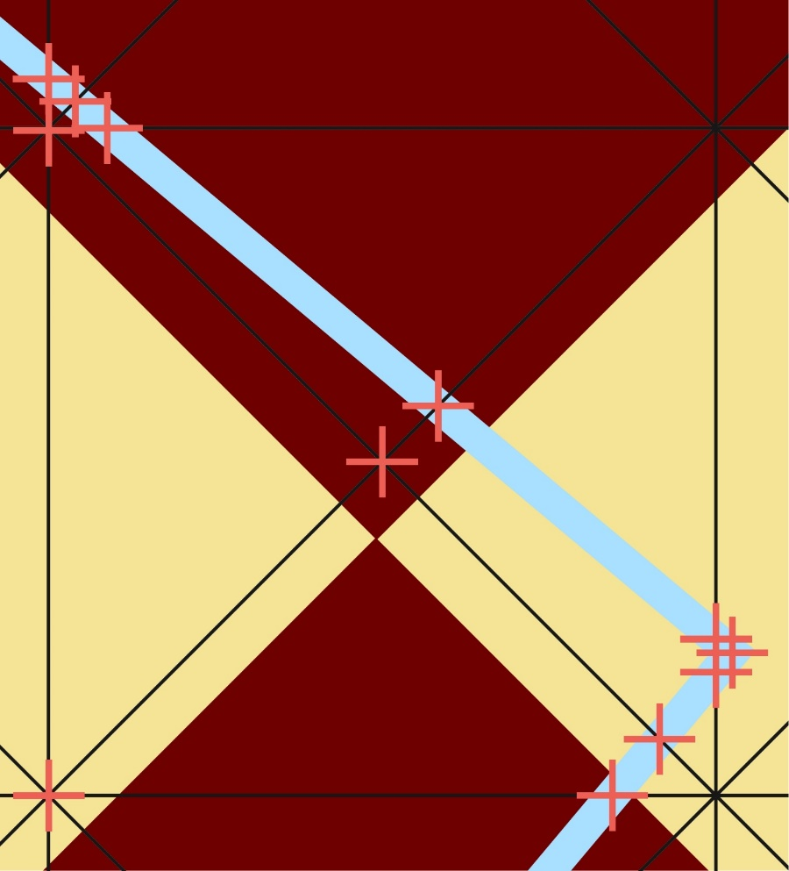
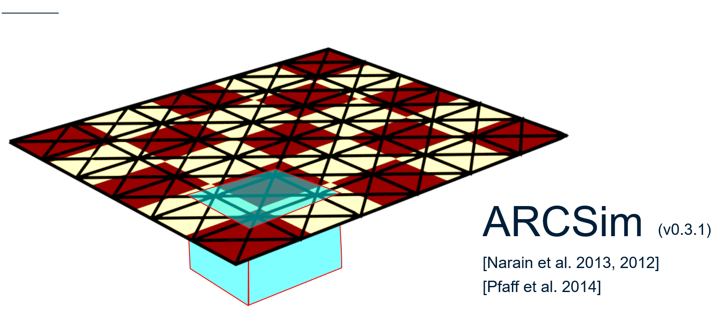
Dynamic Remesh
Collision, preprocess, remesh
Collision

Slide 15

Dynamic Remesh
Collision, preprocess, remesh
Problems
Moving edges create bad triangles
Collision occur very close together
Preserved Edge
Notes:
Introduce this preserved edge
It’s moved in material space this direction
This triangle can get really thin and run the risk of inverting
Collision are all really close
Marking everything for preservation doesn’t leave ARCSim proper remeshing freedom
Also cause similar problems as explained before

Slide 16
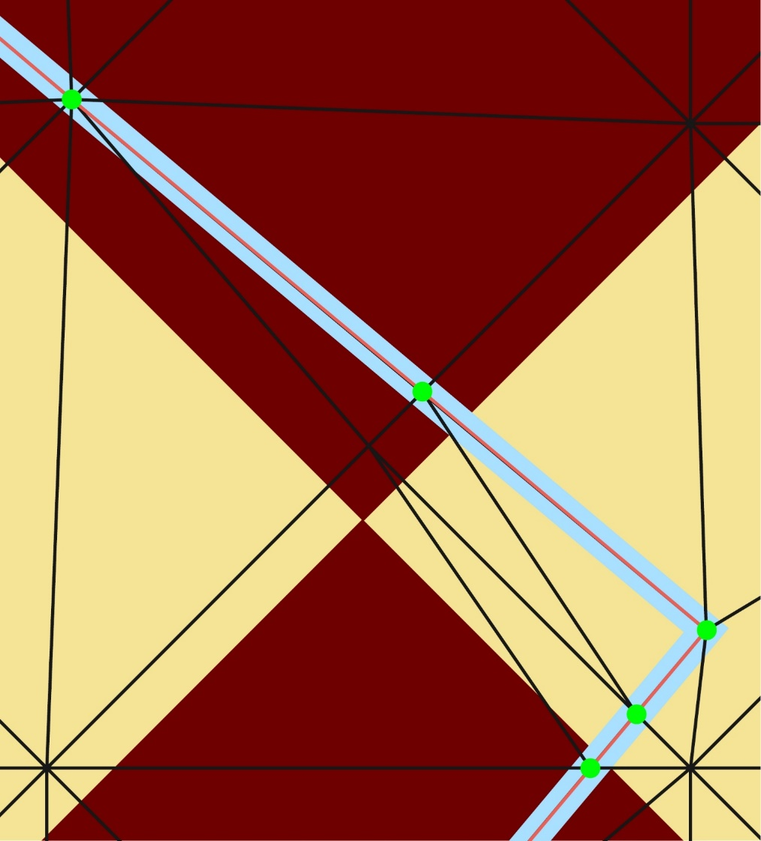
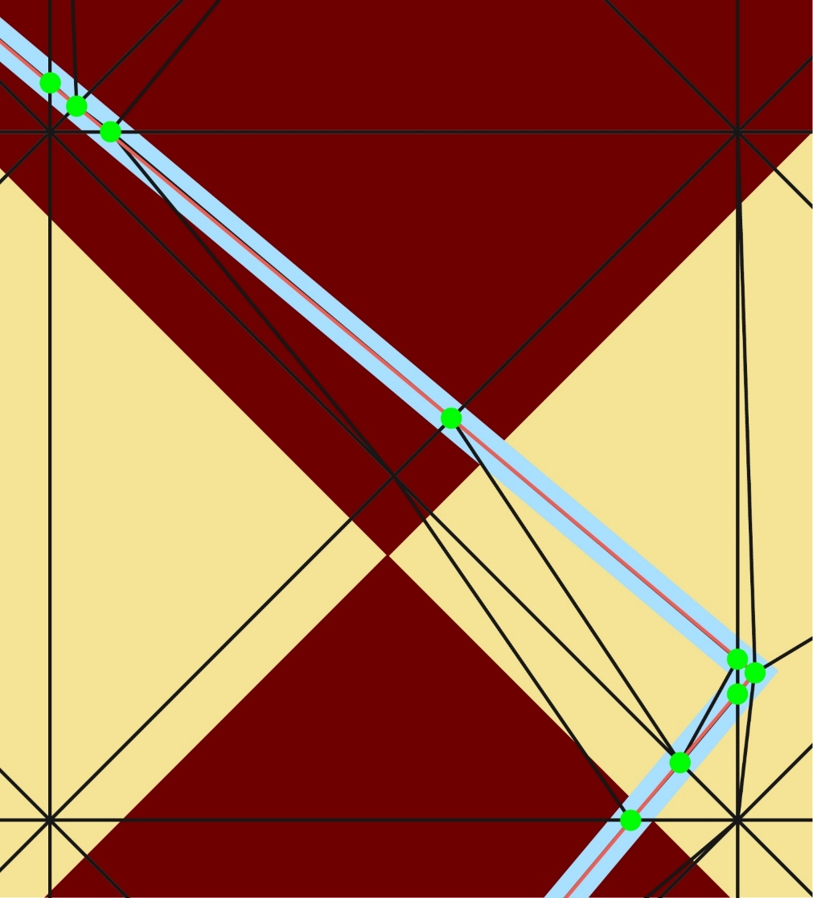
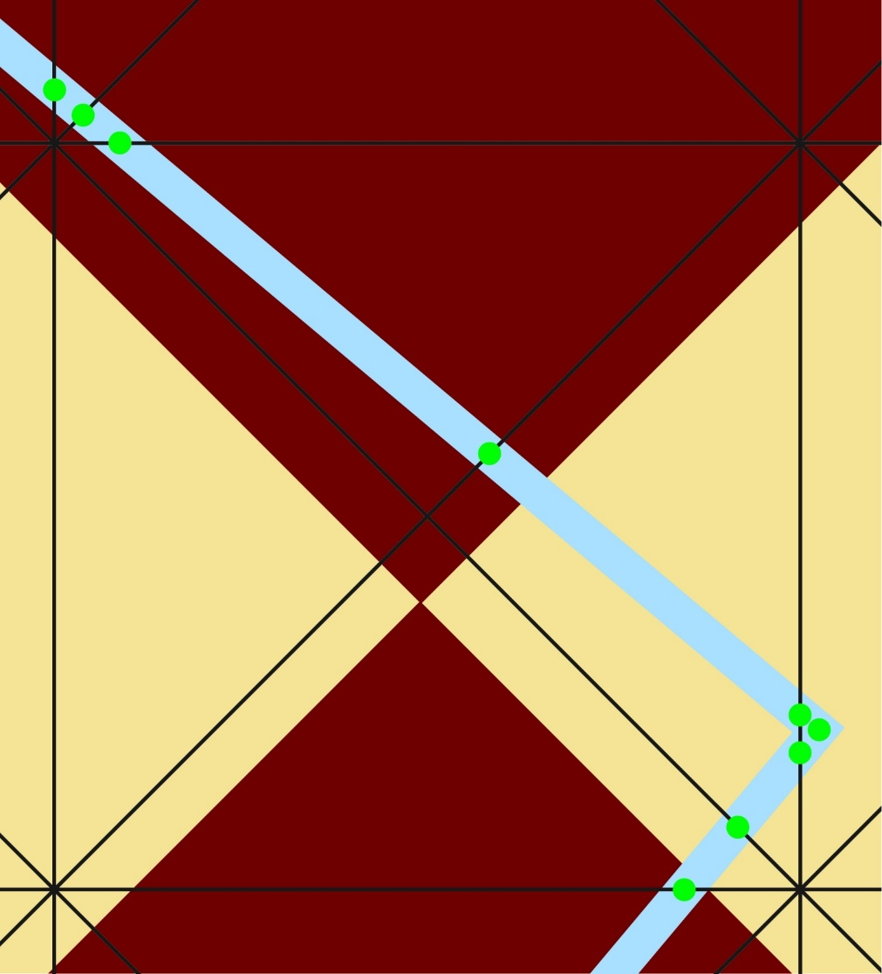
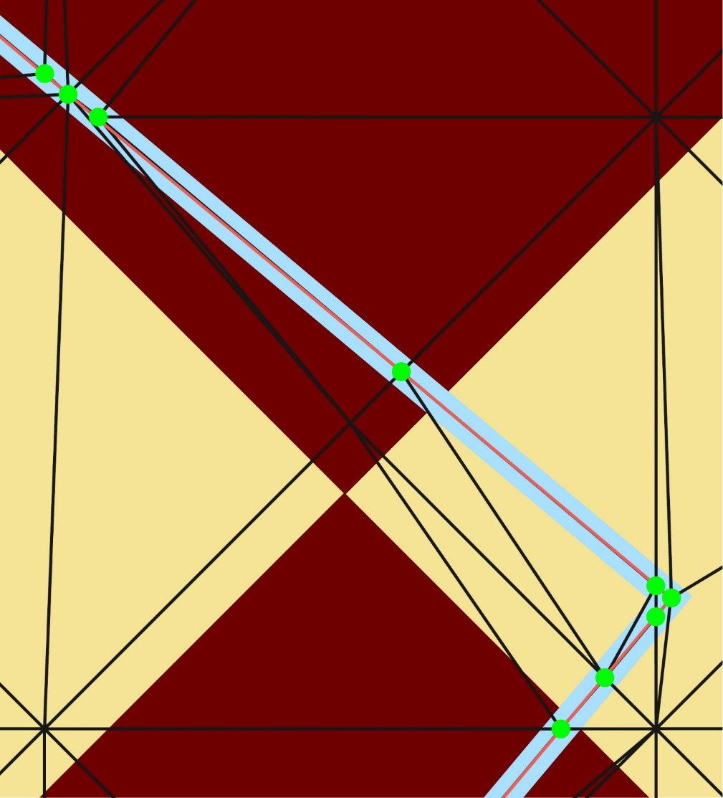
Dynamic Remesh
Collision, preprocess, remesh
Operations
Create points
Add to mesh
Collapse onto EOL points
Collapse between EOL points
EOL Point
Preserved Edge
Notes:
We introduce a supliment of remeshing operations to keep the mesh in order
Unconstrained edge collapses remove at risk triangles
What we can now handle is the introduction of cloth geometry to conform to any edge or point in an object we want
This remeshing in the presence of fixed constrains not handled by standard methods.
These new points as mentioned are our EOL DOF points, and everything else in our mesh acts as it would before

Slide 17
Result
demos

Slide 18
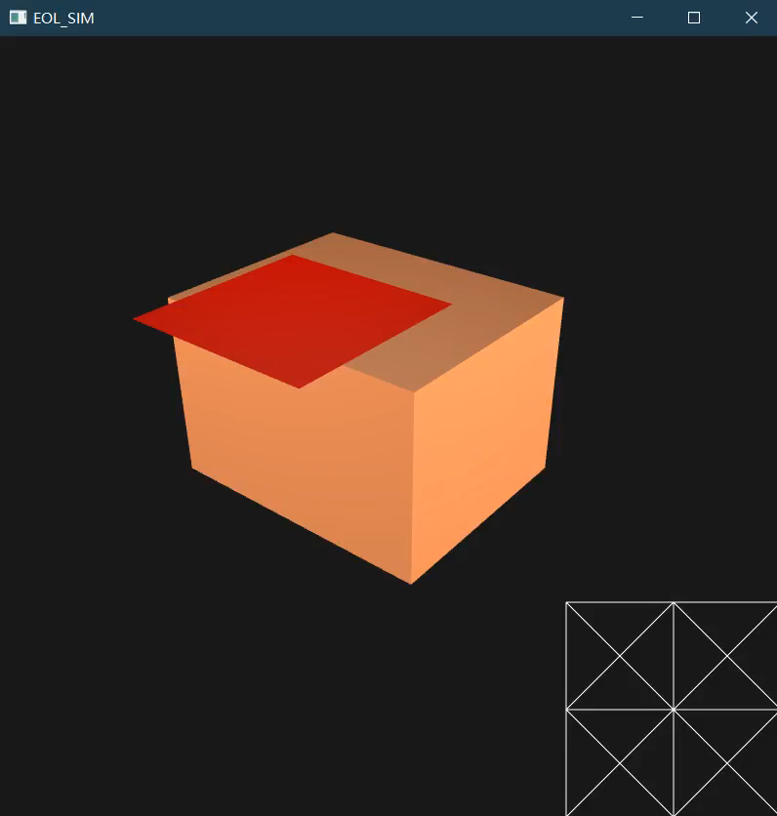
Result
Demos

Slide 19
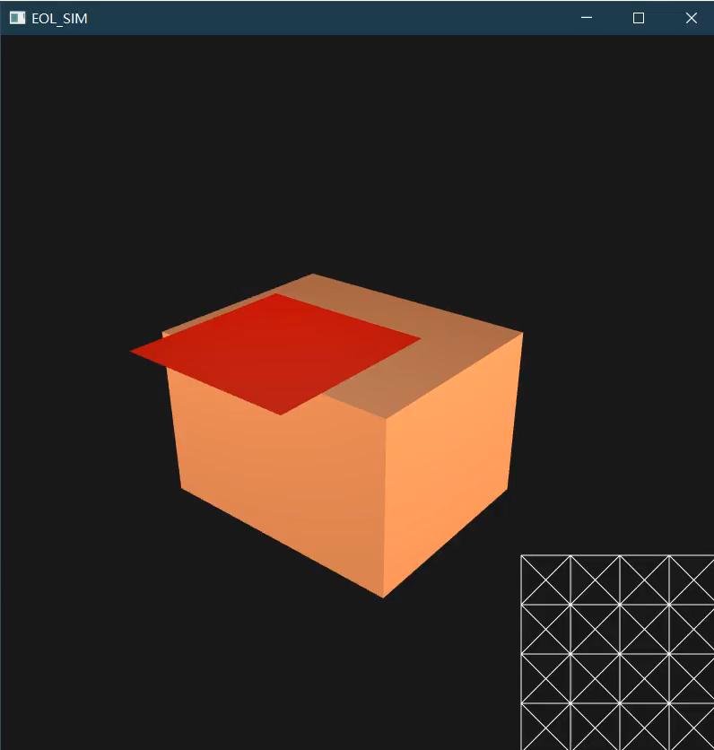
Result
Demos

Slide 20
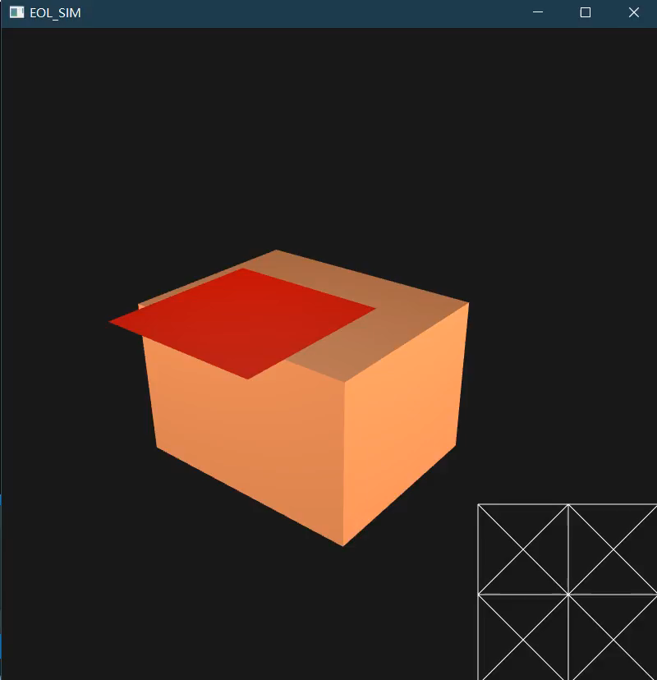
Result
Demos

Slide 21
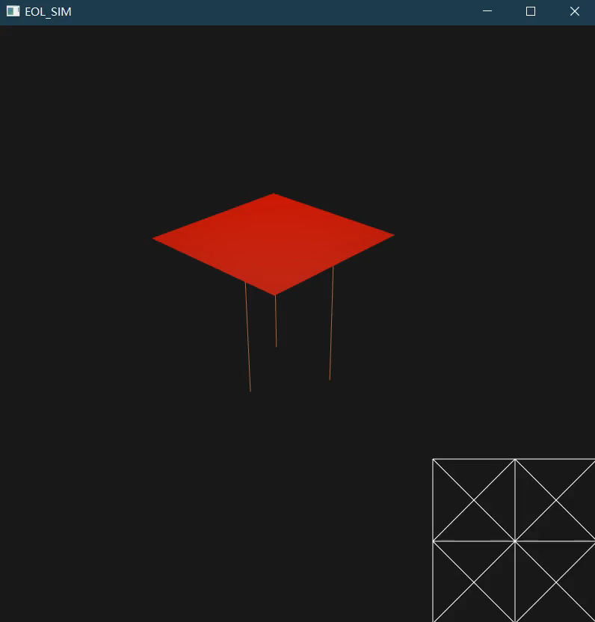
Result
Demos

Slide 22
Thanks for attention.

